Slide 1

FAKE NEWS DETECTION
Using Machine Learning Algorithms

Slide 2
INTRODUCTION
Machine learning (ML) is an artificial intelligence (AI) application that allows systems to automatically learn and improve based on their experiences without the need for explicit programming in advance. It is the study of computer algorithms that can self-improve as a result of experience and data collection and analysis.
Machine learning algorithms build a model based on sample data, known as training data, in order to make predictions or make judgments.
Computer vision, medicine, email filtering, and speech recognition are just a few of the fields where machine learning algorithms are being used to solve problems where traditional algorithms would be difficult or impossible to create.We start the learning process.
Computational learning theory is a branch of theoretical computer science that investigates the computational analysis and performance of machine learning algorithms.
Given the scarcity of training sets and the uncertainty surrounding the future, learning theory does not always provide guarantees about algorithm performance. Instead, in computer science applications, probabilistic bounds on performance are fairly common. One method for estimating generalisation error is the bias–variance decomposition.
In order to achieve the best generalisation performance, the hypothesis's complexity should be proportional to the complexity of the function underlying the data. Likewise, if the hypothesis is simpler than the function, the model will have under-fitted the observed data. If the complexity of the problem is increased, the training error decreases.

Slide 3
EXPERIMENT DESCRIPTION (Without Feature Selection)
Step 1: Import all the sklearn libraries like ( sklearn.model_selection import train_test_split,
sklearn.metrics import accuracy_score) and also Numpy and pandas.
Step 2: Importing Fake news and True news csv files using pd.read_csv function.
Step 3: We are implementing a class column in both Fake news and True news datasets where we are representation Fake news as 0 and True news as 1.
Step 4: We created a variable MARGE and we are using a function concat where we are merging Fake news and True news datasets.
Step 5: By using the function column we are getting an output showing what are the columns present in the dataset and their respective data types.
Step 6: By using drop function we dropping all the unnecessary columns from the dataset.
Step 7: Using isnull we are finding out how many null values are there in the remaining dataset.
Step 8 By using sample function we are shuffling dataset.

Slide 4
Step 9: We created a function wordopt which convert the text in lowercase, remove the extra space, special chr., ulr and links and applying it in text column.
Step 10: We are taking 2 variables X & Y and assigning them with Text Column & Class Column respectively.
Step 11: We are implementing vectorization and splitting the datasets into testing set and training set.
Step 12: Now we will be implementing classifiers on the testing dataset like Decision Trees, SVM, ANN, KNN, Naive Bayes.
Decision Trees:
Importing libraries (sklearn.tree import DecisionTreeClassifier, sklearn.metrics import classification_report, confusion_matrix)
Assigning DT as an object of decision tree classifier.
Using fit function we are fitting testing set and training set.
Using predict function we are performing a prediction for each testing set.
Using score function we are finding out the accuracy of the model.
The classification_report function is helping us in finding the precision, recall, F1 score & accuracy.
By using confusion matrix function we are finding out the confusion matrix.
Lastly, by using metrics library we are finding out the error.

Slide 5
Naive Bayes:
Importing libraries (sklearn.naive_bayes import BernoulliNB )
Assigning BNB as an object of Bernoulli naive bayes.
Using fit function we are fitting testing set and training set.
Using predict function we are performing a prediction for each testing set.
Using score function we are finding out the accuracy of the model.
The classification_report function is helping us in finding the precision, recall, F1 score & accuracy.
By using confusion matrix function we are finding out the confusion matrix.
Lastly, by using metrics library we are finding out the error.
KNN:
1. Importing libraries (sklearn.neighbors import KNeighborsClassifier)
2. Assigning ng as an object of KNeighborsClassifier.
3. Using fit function we are fitting testing set and training set.
4. Using predict function we are performing a prediction for each testing set.
5. Using score function we are finding out the accuracy of the model.
6. The classification_report function is helping us in finding the precision, recall, F1 score & accuracy.
7. By using confusion matrix function we are finding out the confusion matrix.
8. Lastly, by using metrics library we are finding out the error.

Slide 6
SVM:
Importing libraries (sklearn.svm import LinearSVC)
Assigning LS as an object of LinearSVC.
Using fit function we are fitting testing set and training set.
Using predict function we are performing a prediction for each testing set.
Using score function we are finding out the accuracy of the model.
The classification_report function is helping us in finding the precision, recall, F1 score & accuracy.
By using confusion matrix function we are finding out the confusion matrix.
Lastly, by using metrics library we are finding out the error.
ANN:
Importing libraries (sklearn.neural_network import MLPClassifier)
Assigning ANN as an object of MLPClassifier.
Using fit function we are fitting testing set and training set.
Using predict function we are performing a prediction for each testing set.
Using score function we are finding out the accuracy of the model.
The classification_report function is helping us in finding the precision, recall, F1 score & accuracy.
By using confusion matrix function we are finding out the confusion matrix.
Lastly, by using metrics library we are finding out the error.

Slide 7
EXPERIMENT DESCRIPTION ( With Feature Selection)
Step 1: Import all the sklearn libraries like ( sklearn.model_selection import train_test_split,
sklearn.metrics import accuracy_score) and also Numpy and pandas.
Step 2: Importing Fake news and True news csv files using pd.read_csv function.
Step 3: We are implementing a label column in both Fake news and True news datasets where we are representation Fake news as 0 and True news as 1.
Step 4: Importing nltk library we are downloading a keyword named stopwords.
Step 5: By using concat function we are merging both Fake and True news dataset and saving it in a variable new_dataset.
Step 6: By using sample function we are shuffling the whole dataset.
Step 7: Using isnull we are finding out how many null values are there in the remaining dataset.
Step 8: We are creating a column content and merging two columns which can reduce the computational time and power of the model. (This process is known as Feature Engineering)
Step 9: This process is known as steaming. Steaming is a process of reducing a word to its root word.
Step 10: We are applying this steaming function in the column content.
Step 11: We are taking 2 variables X & Y and assigning them with content Column & label Column respectively.
Step 12: We are implementing vectorization and splitting the datasets into testing set and training set.
Step 13: Now we will be implementing classifiers on the testing dataset like Decision Trees, SVM, ANN, KNN, Naive Bayes.

Slide 8
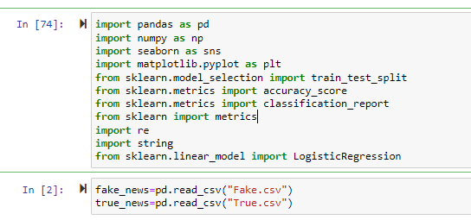
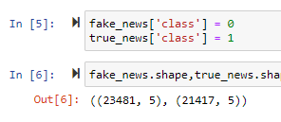
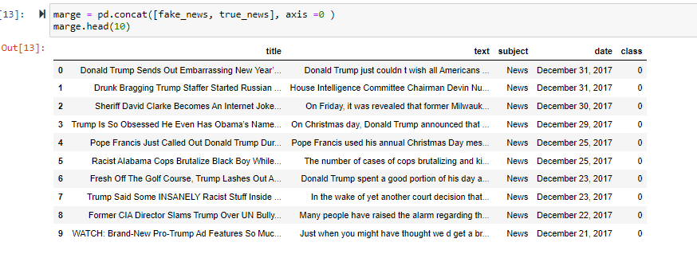
SNAPS OF CODE (WITHOUT FEATURE SELECTION)

Slide 9
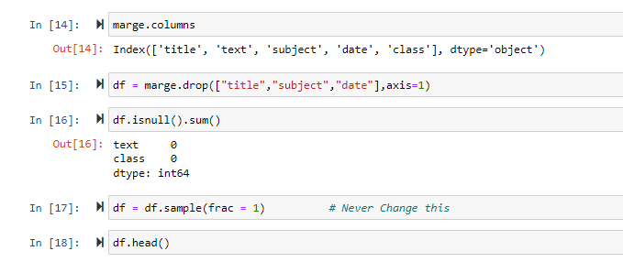
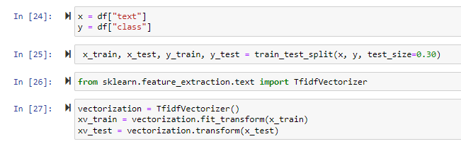
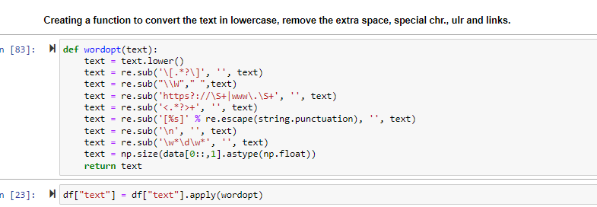

Slide 10
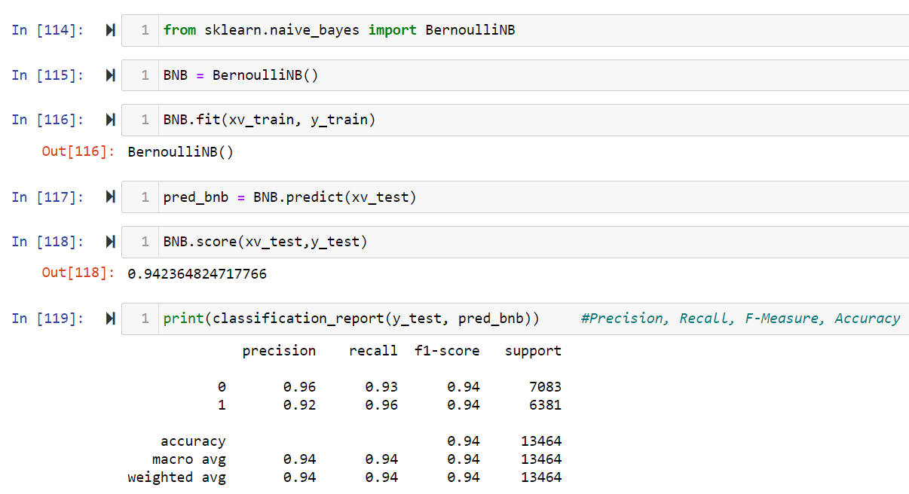
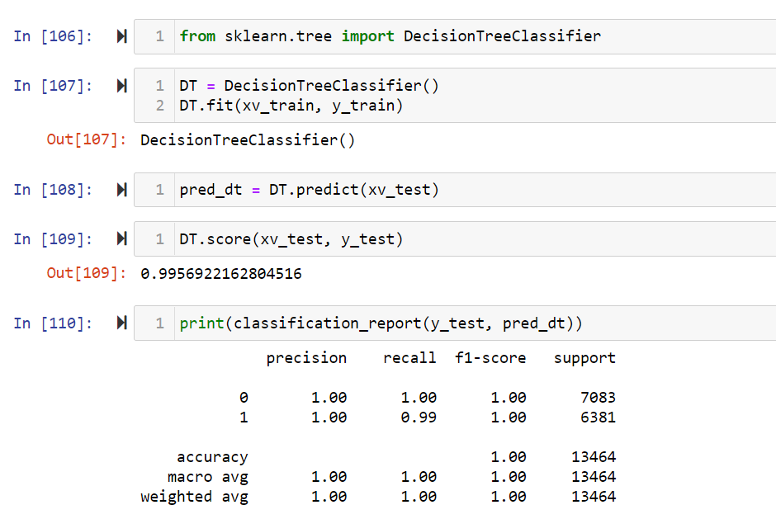
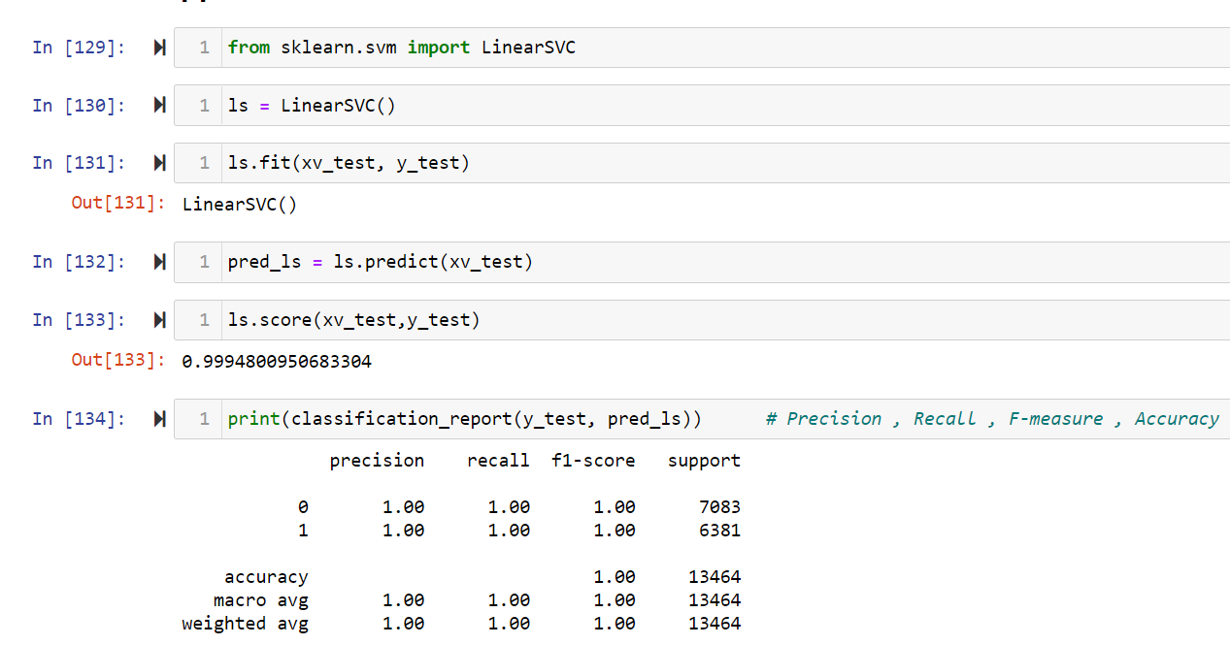
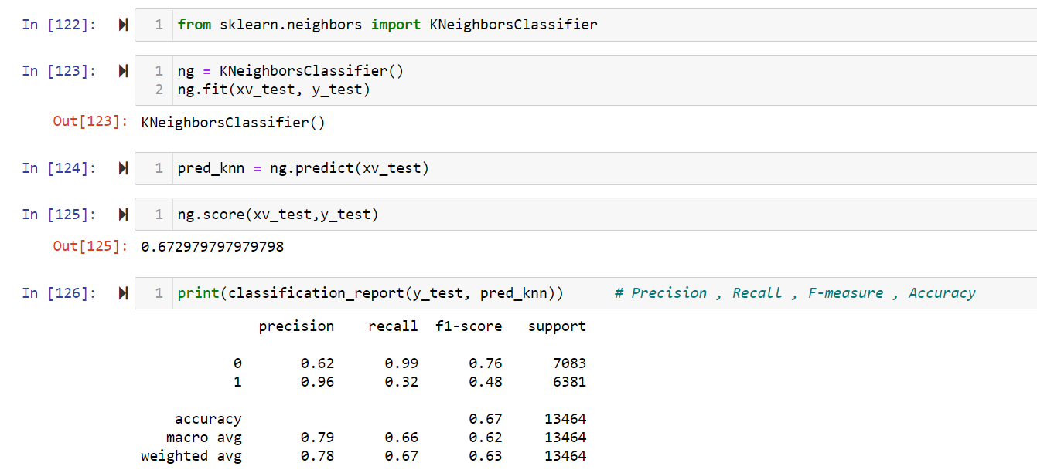

Slide 11
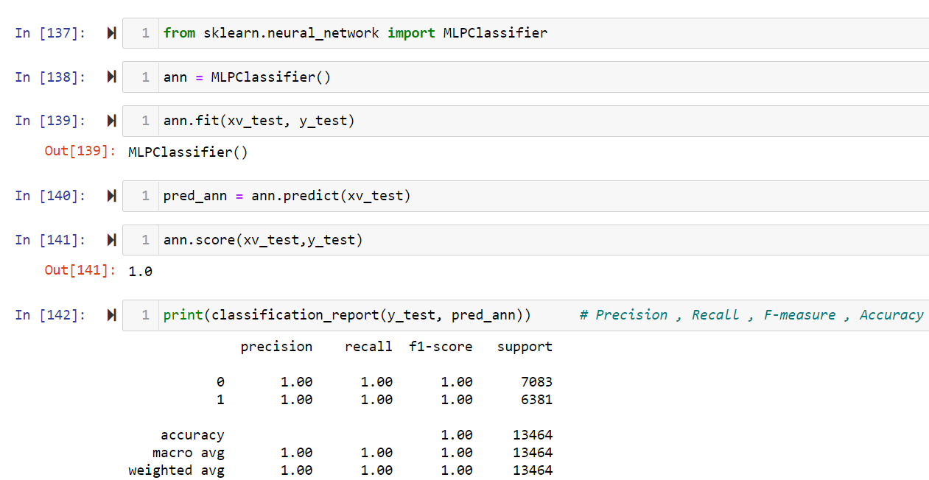

Slide 12
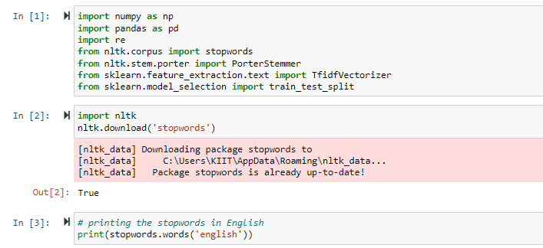
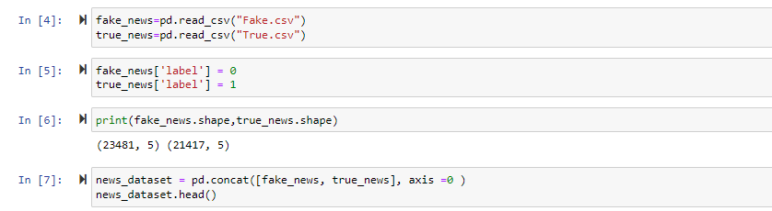
CODE USING FEATURE SELECTION

Slide 13
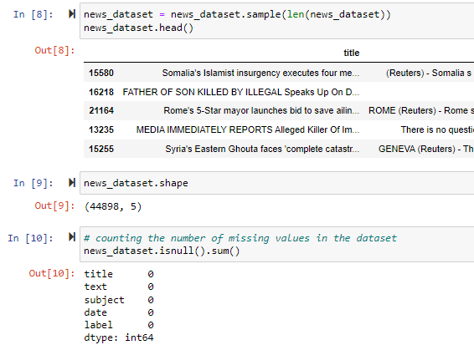
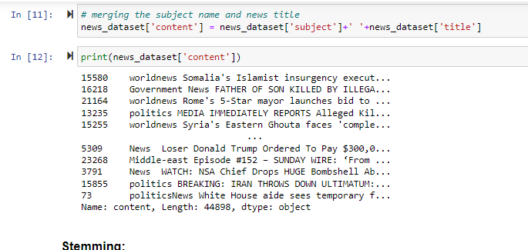

Slide 14
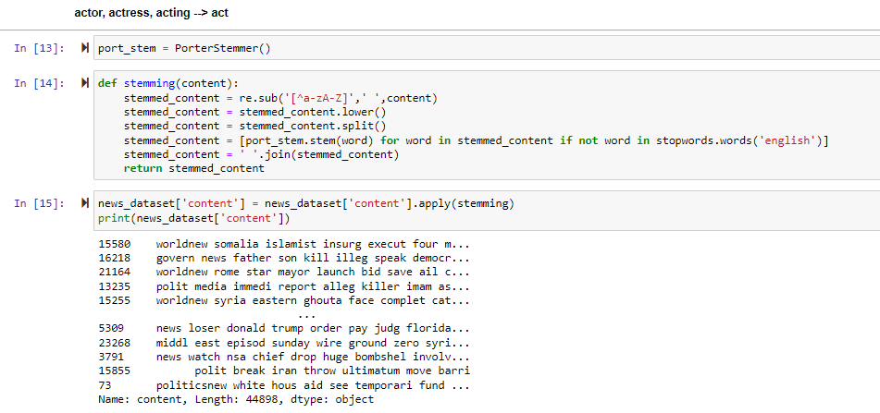

Slide 15
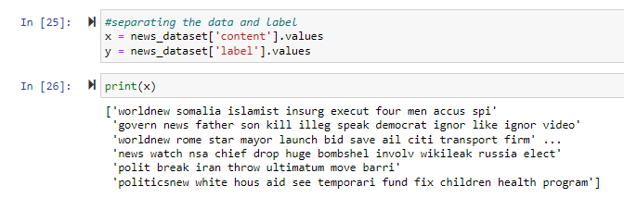
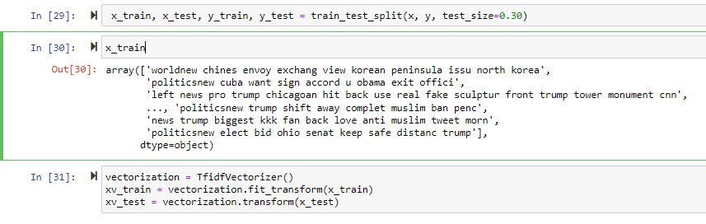

Slide 16
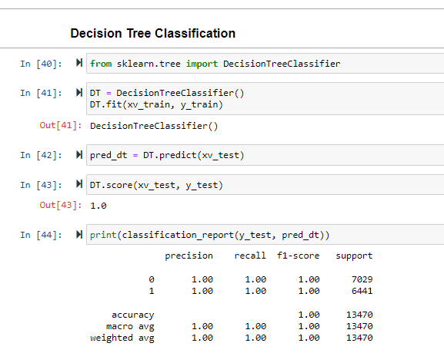
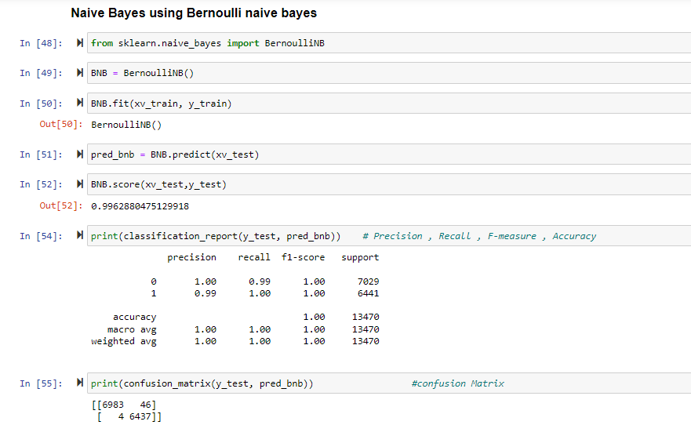

Slide 17
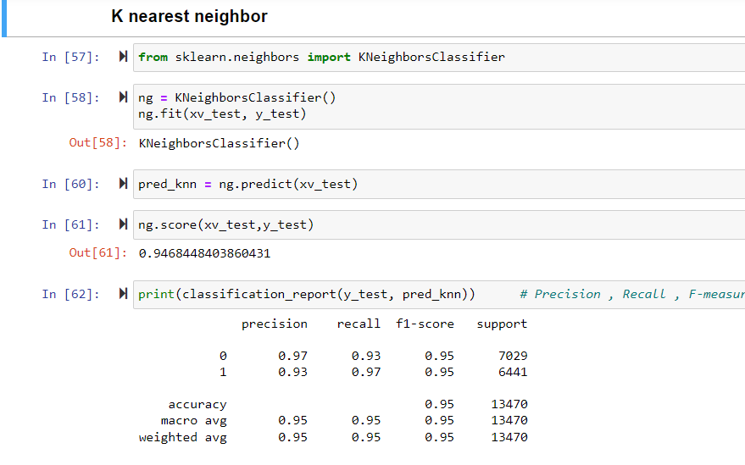
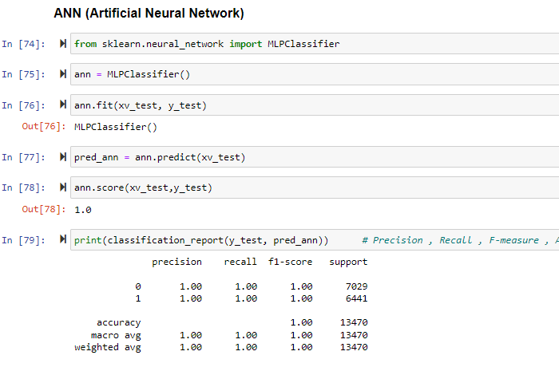

Slide 18
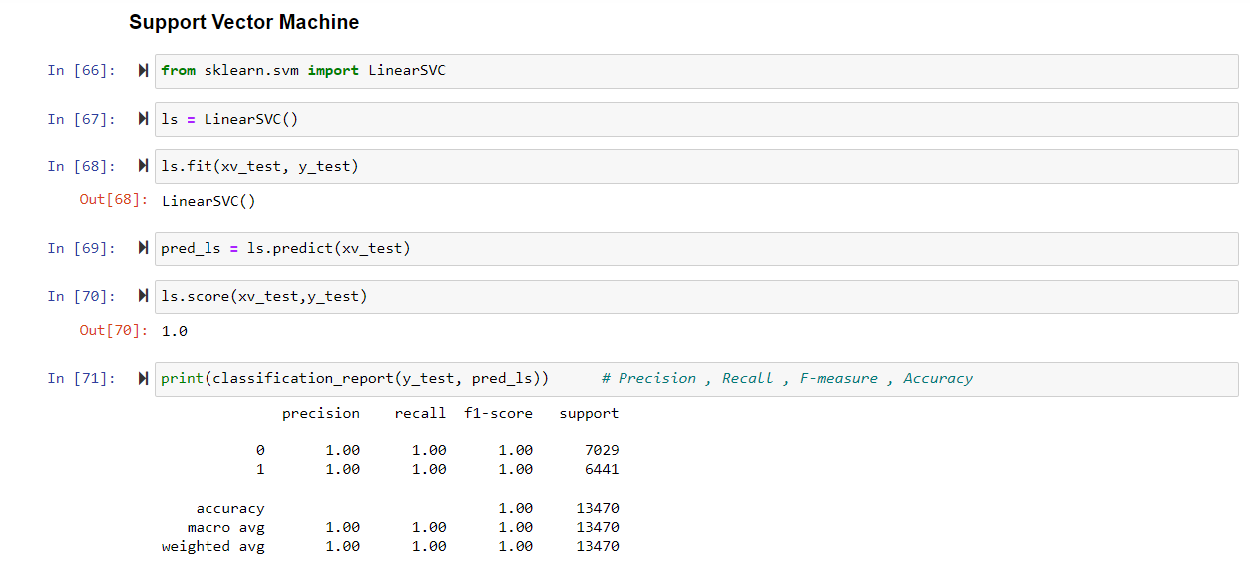

Slide 19
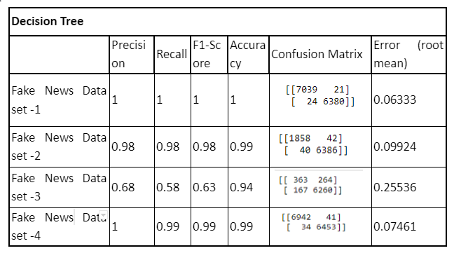
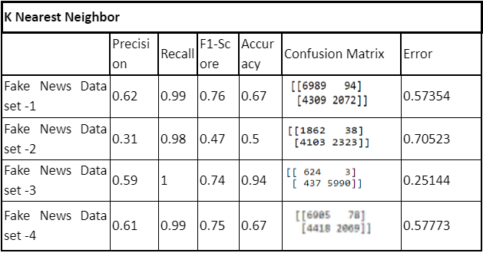
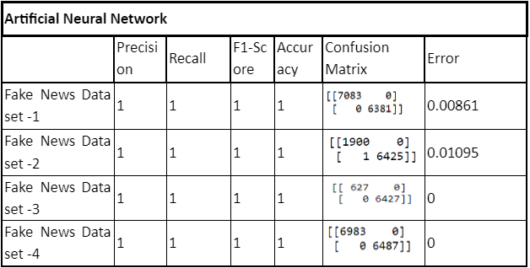
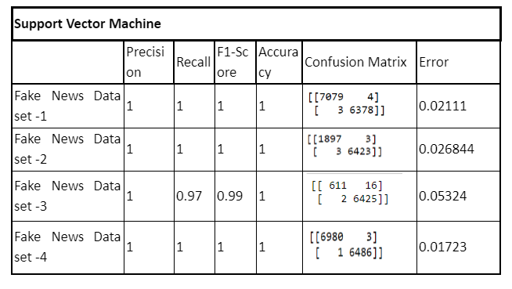
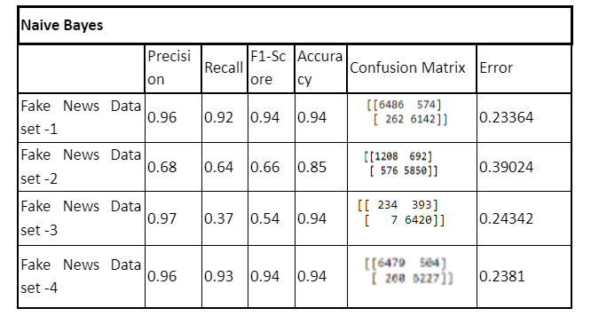
RESULT ANALYSIS (without feature selection)

Slide 20
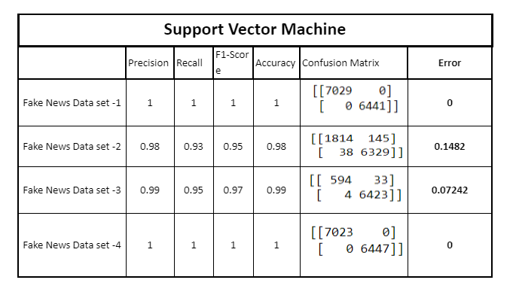
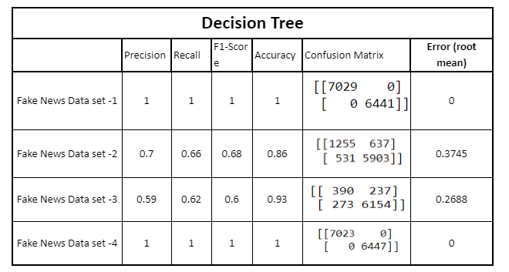
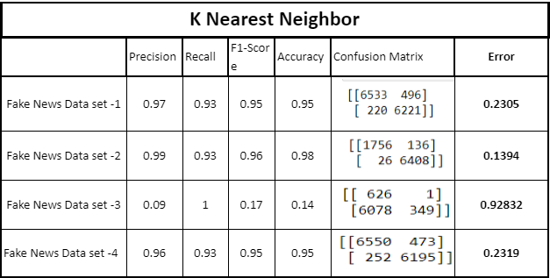
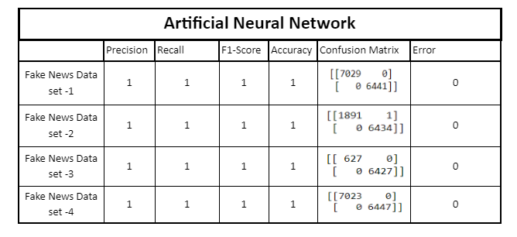
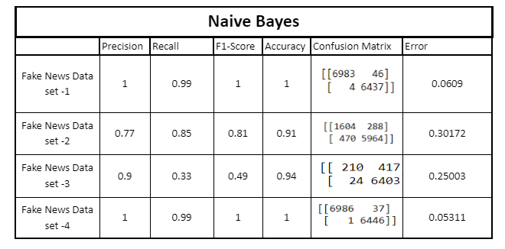
RESULT ANALYSIS (with feature selection)

Slide 21
CONCLUSION
Finally, classification learning algorithms can be benefitted from the abundance of training data. This work has examined several human annotated datasets that may be utilised for training a machine that successfully detects false news. A generalised model that is able to capture the characteristics of each dataset and learn what is valid and what is not, may be trained on many datasets, providing that they are correctly prepared and supplied to the model.
Despite the relative amount of existent studies addressing fake news detection, there is still plenty of opportunity for experimentation, and the discovery of new insights on the nature of false news may lead to more efficient and accurate models. In addition, this research is, to the best of our knowledge, the first to suggest generalisation of models used for false news identification. As shown in this article, such models tend to operate well on a given dataset, but do not generalise well. New boundaries can be explored by examining generalisation of false news detection algorithms.
Looking at all the results derived after implementing the following classifiers : 1. Decision Trees 2. Naive Bayes 3. KNN 4. ANN 5. SVM on the 4 Fake News Datasets we have arrived at a conclusion that ANN is the most efficient algorithm as it gives the best precision and accuracy and least error.

Slide 22
THANK YOU!
BY:
Adrita Chatterjee(1929133)
Avirup Chattopadhyay(1929209)
Harsh Raj(1929216)
Prayash Mohapatra(1929232)

